Slide 1
INFS 6930 - Final Project
The United States Census Bureau
Project Leader:
Brian Eggenberger - Data Design and Generation
Group Members:
Jon Goldman - VB
Mohamed Yasir - Reports
Aanchal Senapati - Research

Slide 2
Project Objective
Our project acts as a tool for US Census Bureau to handle data of employees, their assigned region, and collected resident’s information. It summarizes the process of collecting, recording, and retrieving the resident’s and employee’s information based on the conditions.

Slide 3
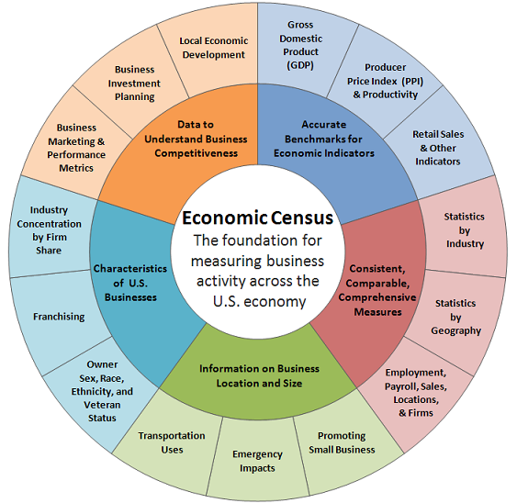
How is Census Data
actually used?
In real life, US census data is used to determine millions of decisions regarding everything from Congressional representation to minute local budgeting decisions.
https://www.census.gov/programs-surveys/economic-census/guidance/data-uses.html

Slide 4
Data Usage - Economics
Census data includes not just people, but also businesses by type and location. Companies can use this data to evaluate where to best locate their stores to minimize competition.
Census data including race, poverty, and a multitude of other factors is used to determine how to spend grant money.
https://www.census.gov/programs-surveys/economic-census/guidance/data-uses.html

Slide 5
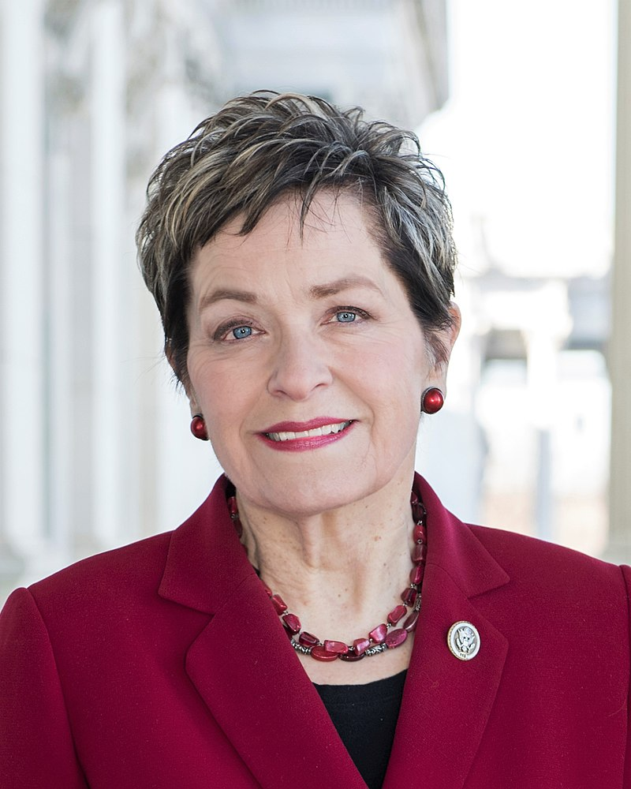
Data Use - Government
The United States Congress is a bicameral legislature composed of the House of Representatives and the Senate.
Senate = 100 seats, 2 per state.
House = 435 seats, at least 1 per state.
Census data determines population of each state.
States with larger populations get more seats.
Ohio has 16, has had 24, previously had 18 2003-13.
Most of Toledo represented by Marcy Kaptur ->

Slide 6
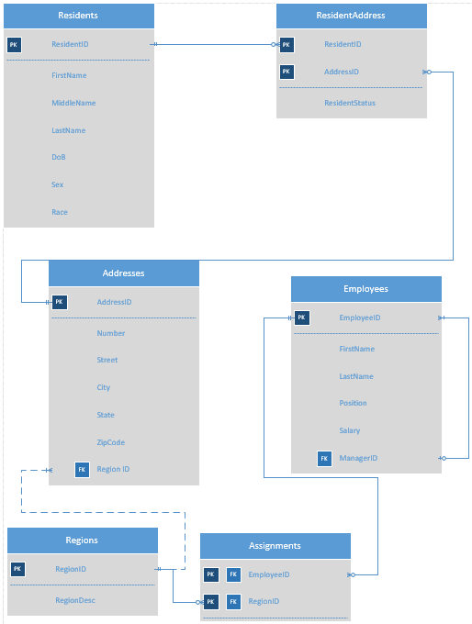
ERD

Slide 7
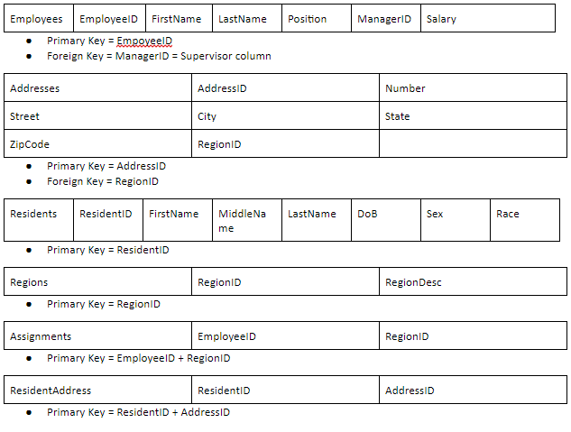
Logical
Model

Slide 8
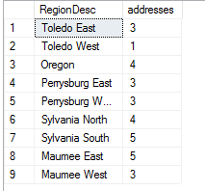
Reporting Examples - 1
For the purposes of staff allocation, you want to figure out how many addresses are in each region.
Now you know how better to allocate your canvassers in order balance the workload efficiently.
select Regions.RegionDesc, Count (addresses.regionid) AS 'addresses'
from Census.Addresses, census.Regions
where (Addresses.regionid = regions.regionid)
group by Addresses.RegionID,Regions.RegionDesc

Slide 9

Reporting Examples - 2
To help cities promote diversity, how many racial minorities live in Perrysburg?
Select COUNT (census.residents.race) AS 'Total Pop', (select COUNT (census.residents.race)
from census.residents, census.addresses, census.residentaddress
where (census.addresses.city = 'perrysburg')
and (census.addresses.addressid = census.residentaddress.addressid)
and (census.residentaddress.residentid = census.residents.residentid)
and (census.residents.race != 'white')) AS 'Minorities'
from census.residents, census.addresses, census.residentaddress
where (census.addresses.city = 'perrysburg')
and (census.addresses.addressid = census.residentaddress.addressid)
and (census.residentaddress.residentid = census.residents.residentid)

Slide 10
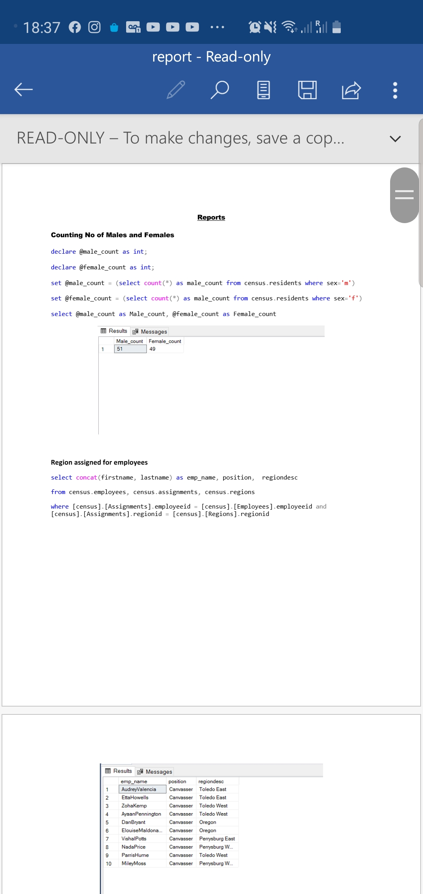
Reporting Example - 3

Slide 11
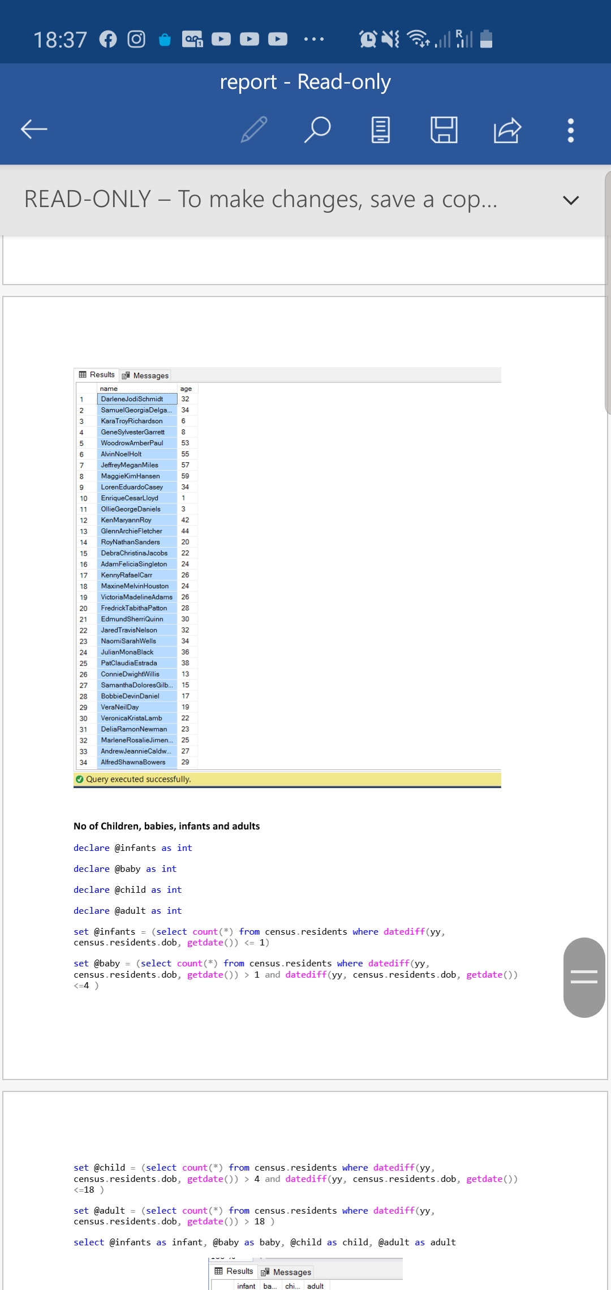
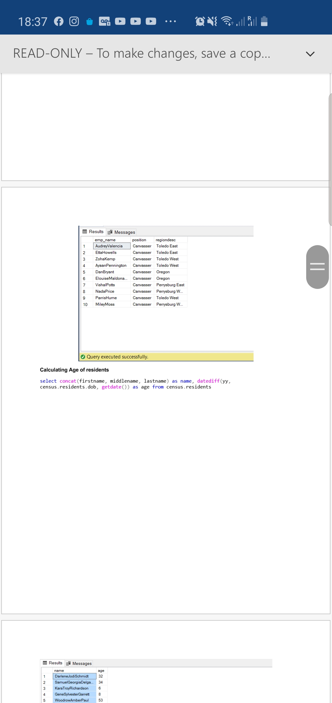
Reporting Example - 4

Slide 12
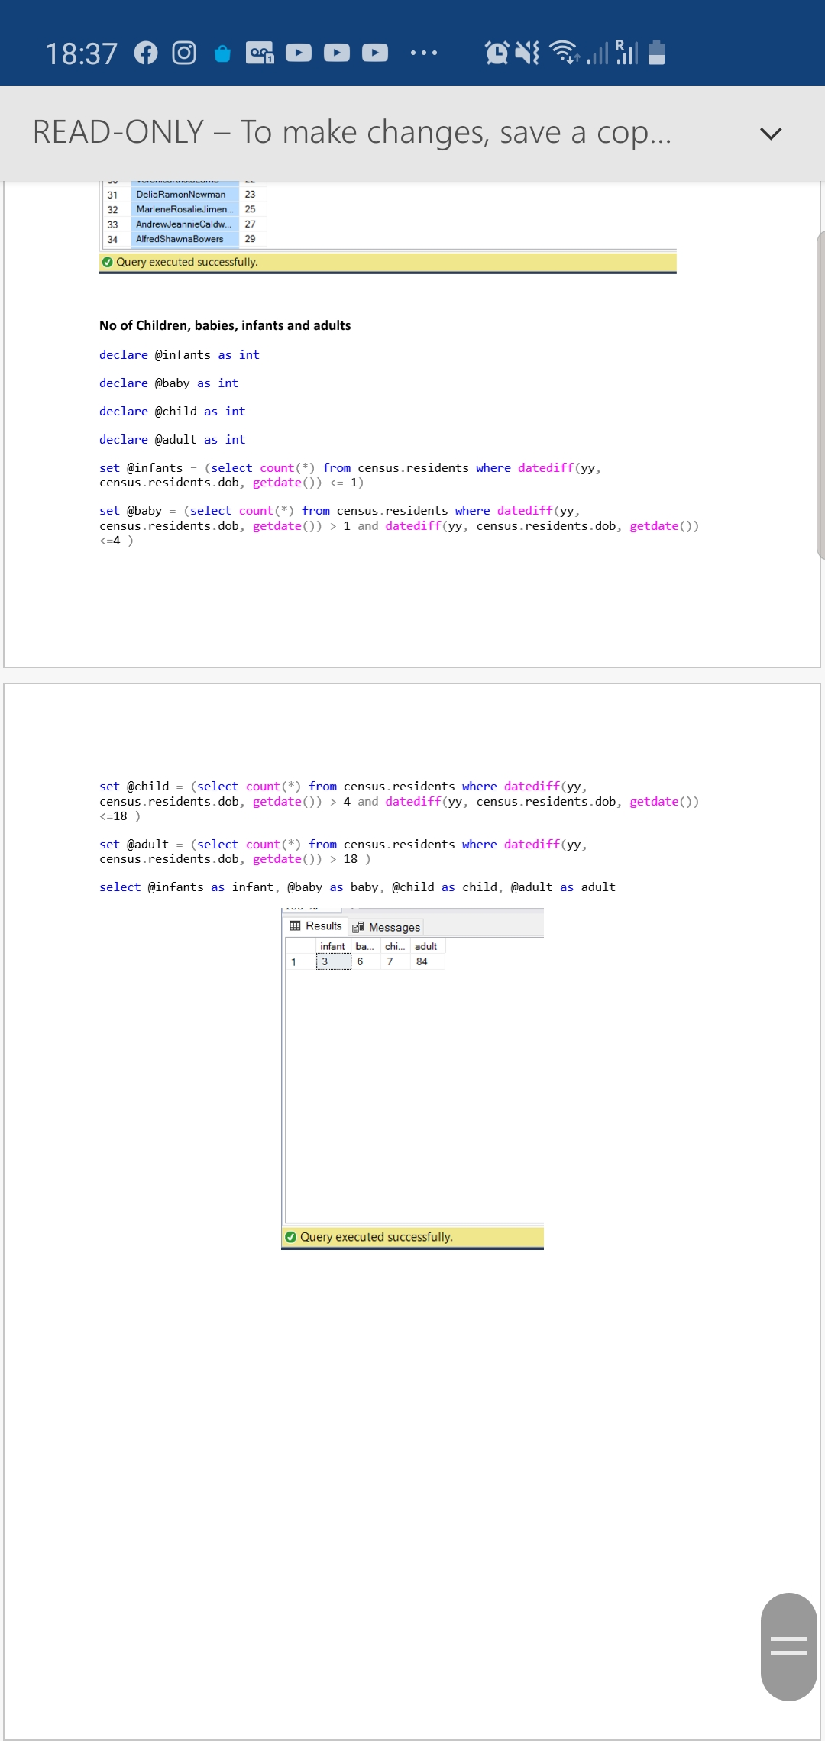
Reporting Example - 5

Slide 13
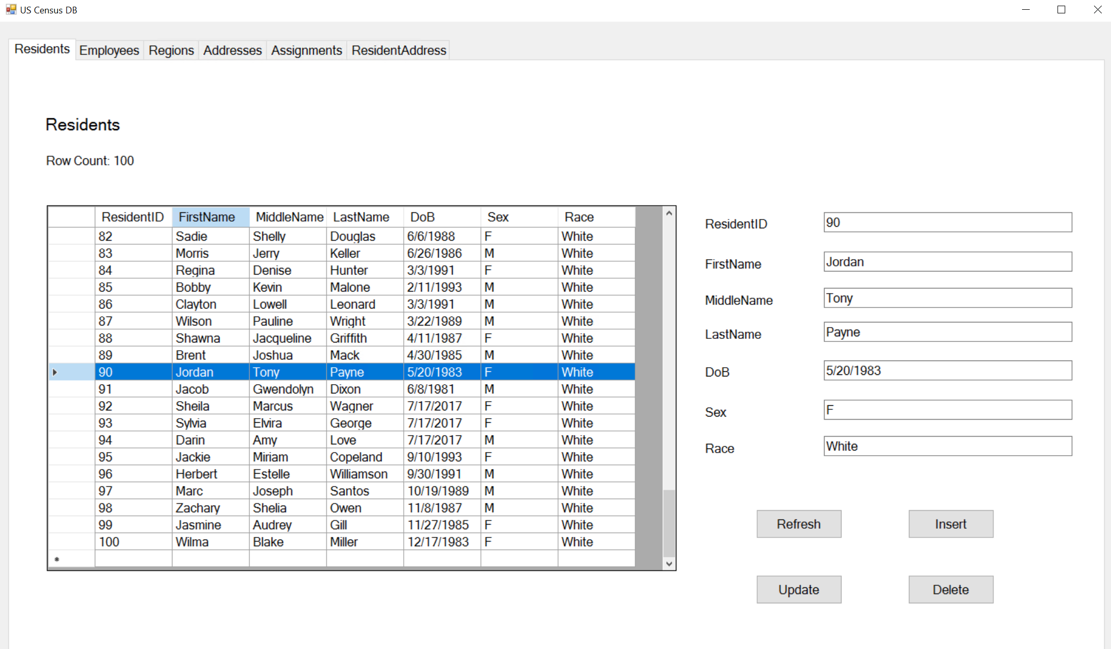
Forms Application

